Slide 1
Membership Inference Attacks Against Machine Learning Models
2017 IEEE symposium on security and privacy (S&P) (Cited: 1941)
张文博 2022.05.26

Slide 2
Abstract
Problem:
We use lots of methods to encrypt and perturb machine learning models.
But how machine learning models leak information ?
Contributions:
The authors focus on the basic membership inference attack: given a data record and black-box access to a model, determine if the record was in the model’s training dataset.
The authors make adversarial use of machine learning and train their own inference model to recognize differences in the target model’s predictions on the inputs that it trained on versus the inputs that it did not train on.

Slide 3
Background：Machine Learning as a service
Cloud computing service type:
SaaS（Software as a Service）
PaaS（Platform as a Service）
IaaS(Infrastructure as a Service)
Google Prediction API
Amazon Machine Learning
Microsoft Azure Machine Learning
BigML.4
These platforms provide simple APIs for uploading the data and for training and querying models, thus making machine learning technologies available to any customer. The details of the models and the training algorithms are hidden from the data owners.

Slide 4

Background： Privacy in Machine Learning
What it means for a machine learning model to breach privacy?
A privacy breach occurs if an adversary can use the model’s output to infer the values of sensitive attributes used as input to the model.
This correlation applies to all members of a given population.
Some people whose data was used to create the model.
Other people from the same population.
Other people whose data was not used and whose identities may not even be known to the model’s creator.

Slide 5
Problem Statement
To bypass the difficulties inherent in defining and protecting privacy of the entire population, we focus on protecting privacy of the individuals whose data was used to train the model.
Assume that the attacker has query access to the model and can obtain the model’s prediction vector on any data record.
Assume that the attacker knows the format of the inputs and outputs of the model, including their number and the range of values they can take.
Assume that the attacker either (1) knows the type and architecture of the machine learning model, as well as the training algorithm, or (2) has black-box access to a machine learning model.
The attacker may have some background knowledge about the population from which the target model’s training dataset was drawn.

Slide 6
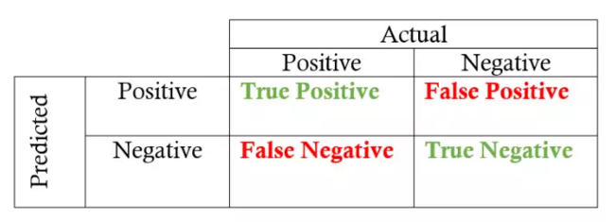

Problem Statement
The setting for inference attack is as follows：
The attacker is given a data record and black-box query access to the target model.
The attack succeeds if the attacker can correctly determine whether this data record was part of the model’s training dataset or not.
The standard metrics for attack accuracy are precision (what fraction of records inferred as members are indeed members of the training dataset) and recall (what fraction of the training dataset’s members are correctly inferred as members by the attacker).
$$precision = TP / (TP + FP)$$
$$recall = TP / (TP + FN)$$

Slide 7
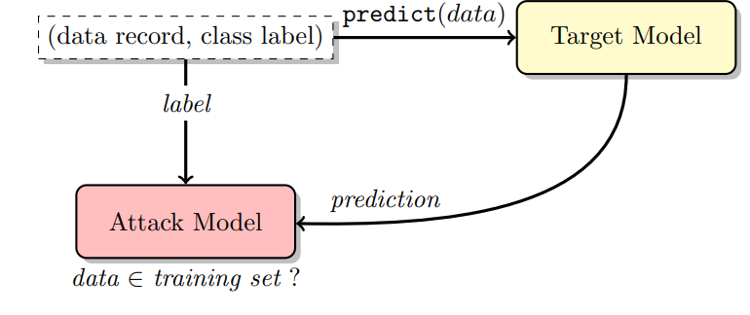
Overview of the attack
For example(3-classification)：
An data record ([0.2, 0.3, 5, 1, 2.5], 1)
The attacker know it is in training set
Cal predict(data) = [0.2,0.7,0.1]
Get x = (1,[0.2,0.7,0.1]), y = 1
Use the sample in ② to train Attack Model
The data that the attacker hold: (data record, class lable) and if data record ∈ training set (In ideal conditions)
Target Model: The model that the attacker will attack
Attack Model: The model trained by attacker

Slide 8
Overview of the attack
The main challenge is the attacker does not actually know the training set of the target model.
For example(3-classification)：
Cal predict(data) = [0.2,0.7,0.1]
Get x = (1,[0.2,0.7,0.1]), y = 1
Use the sample in ② to train Attack Model
An data record ([0.2, 0.3, 5, 1, 2.5], 1)
The attacker know it is in training set
To solve this conundrum, the authors developed a shadow training technique that lets us train the attack model on proxy targets for which we do know the training dataset and can thus perform supervised training.

Slide 9
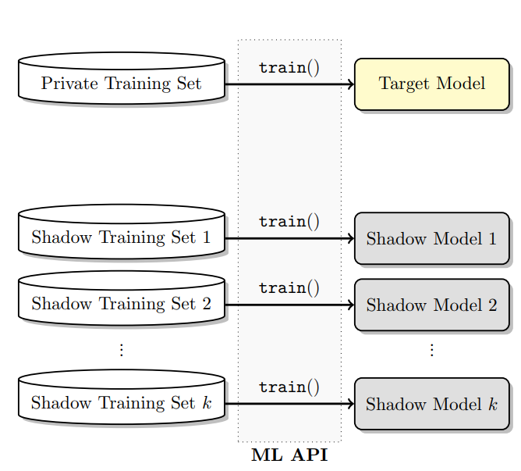
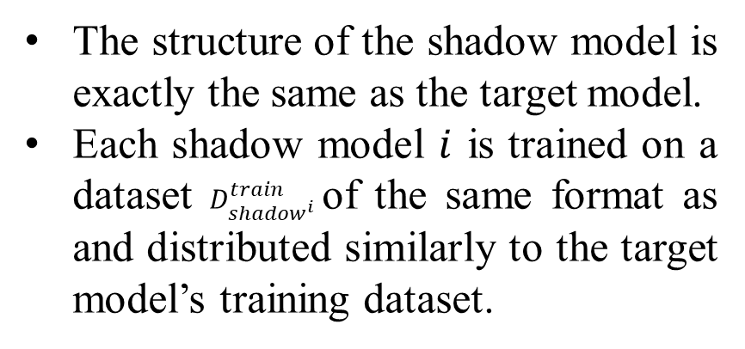
Shadow Training Technique
What is Shadow Model?
The structure of the shadow model is exactly the same as the target model.
Each shadow model $i$ is trained on a dataset $D_{{shadow}^{i}}^{train}$of the same format as and distributed similarly to the target model’s training dataset.
Why we need Shadow Model?
We don't know the training data of the target model.
But we know the training set of the shadow model because it is specified by ourselves.

Slide 10
Shadow Training Technique (Data preparation)
How to generating training data for Shadow Models?
Model-based synthesis: If the attacker does not have real training data nor any statistics about its distribution, he can generate synthetic training data for the shadow models using the target model itself.
Main idea: Records that are classified by the target model with high confidence should be statistically similar to the target’s training dataset and thus provide good fodder for shadow models.
Statistics-based synthesis: The attacker knows the distribution information of target model training set, can directly generate data through distribution.
Noisy real data: The attacker may obtain data similar to the training set of the target model, which can be regarded as a noisy version of the training set.

Slide 11
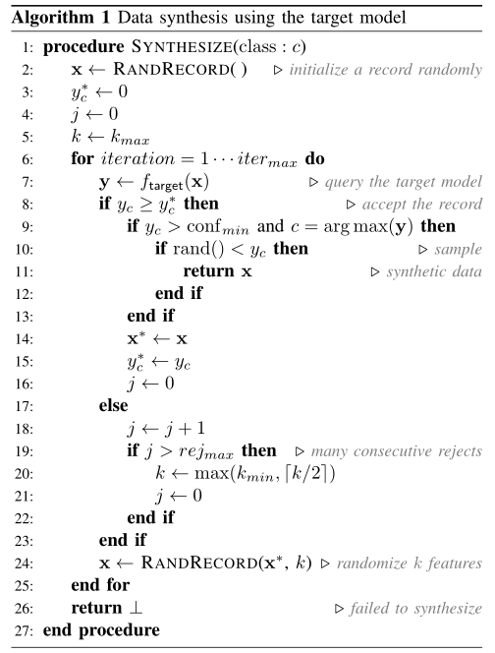
Shadow Training Technique (Data preparation)
Hill Climbing Algorithm
notation | explaination
RANDRECORD | Initialize a record randomly
RANDRECORD(x*, k) | Randomize k features of x*
x | Temp Input data
x* | Best input data
y_{c} | Temp output confidence
y_{c}* | Best output confidence
k | Number of features per change
k_{min} | Minimum number of features per change
j | Number of rejections
rej_{max} | Maximum number of rejections

Slide 12
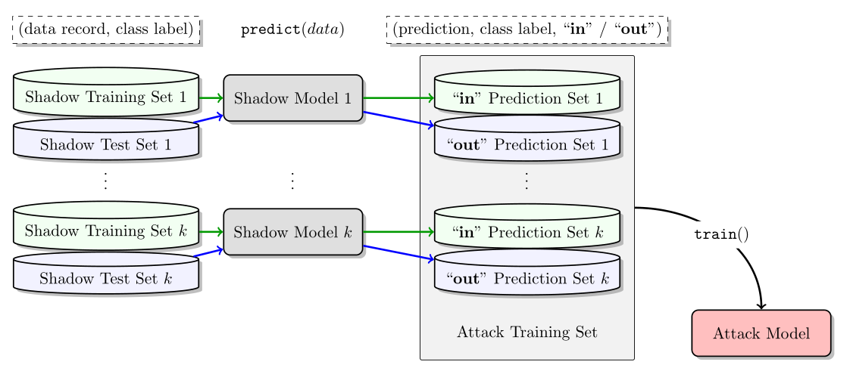
Shadow Training Technique (Training)
(input, output)

Slide 13
Evaluation (Dataset)
CIFAR: CIFAR10 composed of 60000 color images in 10 classes, each image consists of 3× 32 × 32 features about color. The task is to predict the image’s type. (similar to Cifar100)
Purchases: composed of 197324 records in 5 classes, each record consists of 600 binary features about shopping. The task is to predict the data owner’s shopping type.
Locations: Composed of 5010 records in 30 classes, each record consists of 446 binary features about location. The task is to predict the data owner’s geosocial type.
Texas hospital stays: composed of 67330 records in 100 classes, each record consists of 6170 binary features about medicine. The task is to predict the patient’s main procedure.
MNIST: composed of 70000 images in 10 classes, each image consists of 28 ×28 features about color. The task is to predict the image’s type.
UCI Adult (Census Income): composed of 48842 records with 14 attributes. The task is to predict if a person makes over $50K/year based on the census attributes

Slide 14
Evaluation (Target models)
Google Prediction API (Cloud)
Amazon Machine Learning (Cloud)
Neural networks (Local)
Don’t know the model structure (black-box)
Model Struct (For Cifar10)：
Learning rate = 1e-3,
delay to 1e-7
Maximum epochs = 100
Convolutional
Convolutional
Max-pooling
Flatten
Linear
Softmax

Slide 15
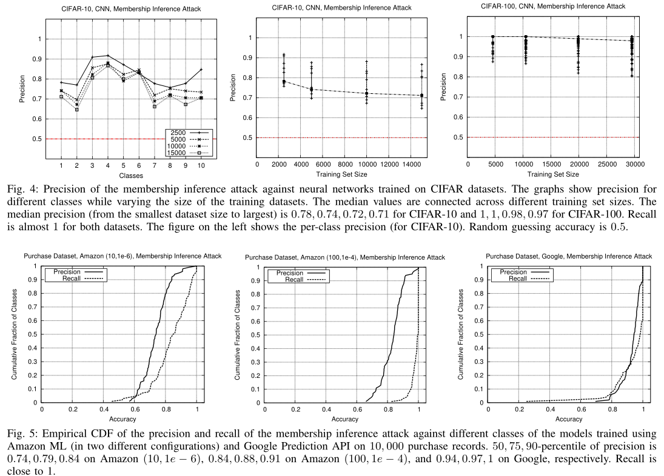
Evaluation (Results)
The attack model get very high precision.
The precision decreases when the training data set is larger (overfitting).

Slide 16
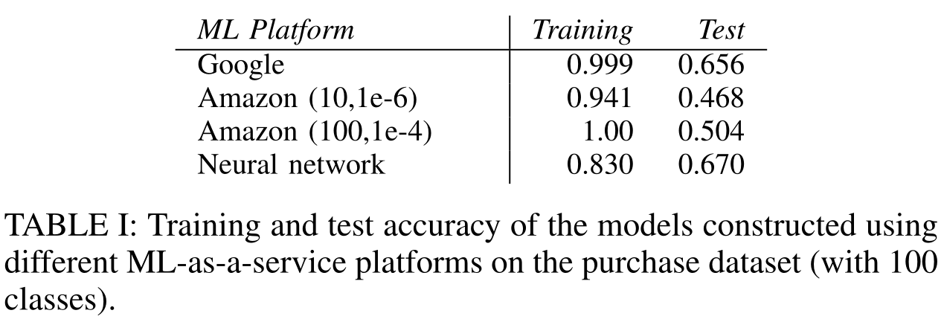
Evaluation (Results)
Accuracy of the attack
For the purchase dataset with 100 classes, large gaps between training and test accuracy indicate overfitting

Slide 17
Evaluation (Results)
Accuracy of the attack

Slide 18
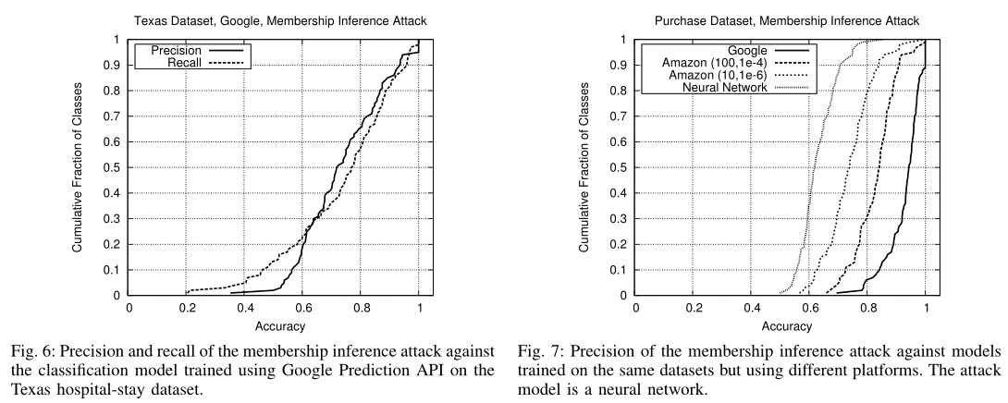
Evaluation (Results)
Accuracy of the attack

Slide 19
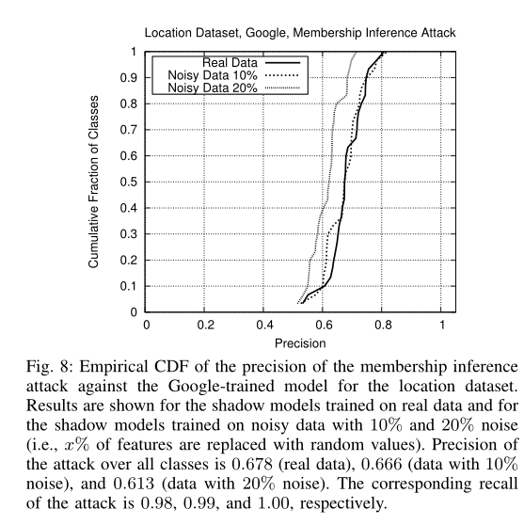
Evaluation (Results)
Effect of the shadow training data
The attacks are robust even if the attacker’s assumptions about the distribution of the target model’s training data are not very accurate.
Notes:
Figure 8 reports precision of the attacks trained on the
shadow models whose training datasets are noisy versions of
the real data (disjoint from the target model’s training dataset
but sampled from the same population). Precision drops as the
amount of noise increases, but t
he attack still outperforms the baseline and, even with 10% of the features in the shadows’
training data replaced by random values, matches the original
attack. This demonstrates that our attacks are robust even
if the attacker’s assumptions about the distribution of the
target model’s training data are not very accurate

Slide 20
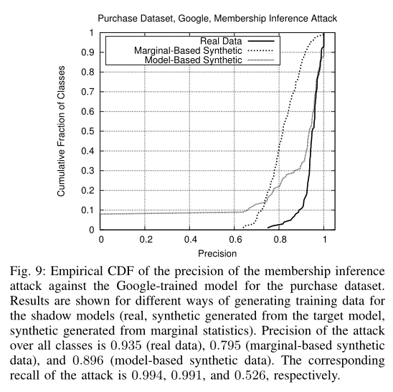
Evaluation (Results)
Effect of the shadow training data
For the majority of the target model’s classes, the attack achieves high precision.
This demonstrates that a membership inference attack can be trained with only black-box access to the target model, without any prior knowledge about the distribution of the target model’s training data if the attacker can efficiently generate inputs that are classified by the target model with high confidence.
Notes:
Figure 8 reports precision of the attacks trained on the
shadow models whose training datasets are noisy versions of
the real data (disjoint from the target model’s training dataset
but sampled from the same population). Precision drops as the
amount of noise increases, but t
he attack still outperforms the baseline and, even with 10% of the features in the shadows’
training data replaced by random values, matches the original
attack. This demonstrates that our attacks are robust even
if the attacker’s assumptions about the distribution of the
target model’s training data are not very accurate

Slide 21
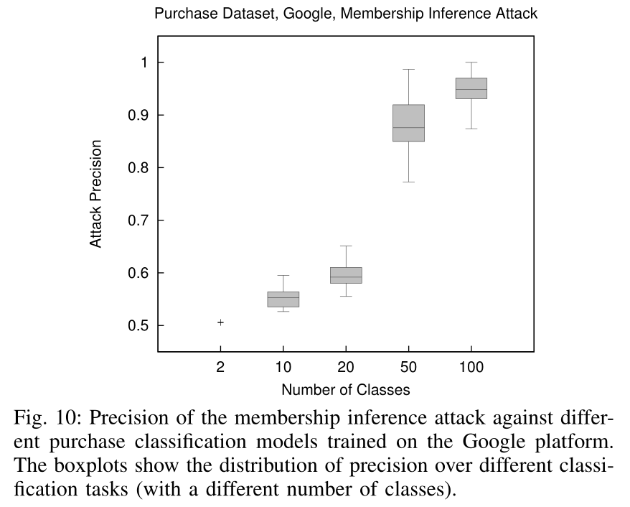
Evaluation (Results)
Effect of the number of classes and training data per class
Figure 10 shows the distribution of attack precision for each model. Models with fewer classes leak less information about their training inputs.
As the number of classes increases, the model needs to extract more distinctive features from the data to be able to classify inputs with high accuracy.
Informally, models with more output classes need to remember more about their training data, thus they leak more information.
Notes:
Figure 8 reports precision of the attacks trained on the
shadow models whose training datasets are noisy versions of
the real data (disjoint from the target model’s training dataset
but sampled from the same population). Precision drops as the
amount of noise increases, but t
he attack still outperforms the baseline and, even with 10% of the features in the shadows’
training data replaced by random values, matches the original
attack. This demonstrates that our attacks are robust even
if the attacker’s assumptions about the distribution of the
target model’s training data are not very accurate

Slide 22
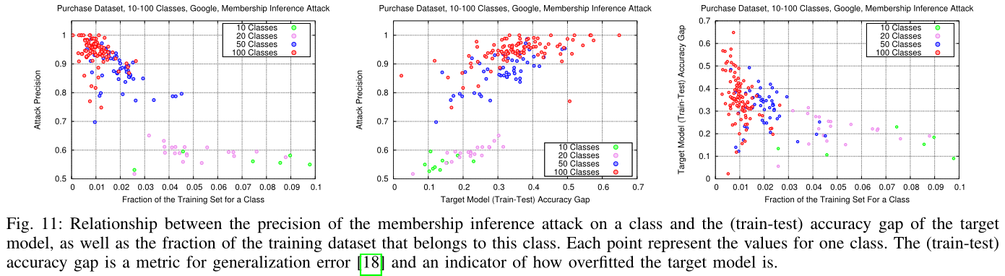
Evaluation (Results)
Effect of the number of classes and training data per class
Figure 11 shows the relationship between the amount of training data per class and the accuracy of membership inference. This relationship is more complex, but, in general, the more data in the training dataset is associated with a given class, the lower the attack precision for that class.
Notes:
Figure 8 reports precision of the attacks trained on the
shadow models whose training datasets are noisy versions of
the real data (disjoint from the target model’s training dataset
but sampled from the same population). Precision drops as the
amount of noise increases, but t
he attack still outperforms the baseline and, even with 10% of the features in the shadows’
training data replaced by random values, matches the original
attack. This demonstrates that our attacks are robust even
if the attacker’s assumptions about the distribution of the
target model’s training data are not very accurate

Slide 23
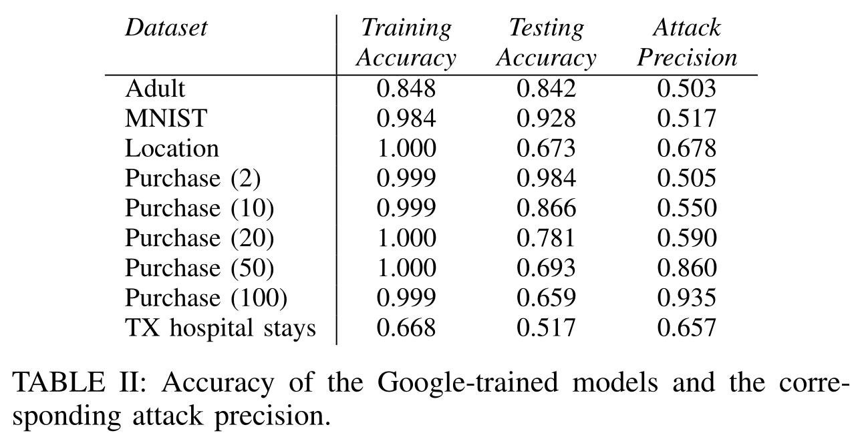
Evaluation (Results)
Effect of the number of classes and training data per class
First, the model is not overfitted.
Second, the model is a binary classifier, the two outputs are complements of each other.
The lack of randomness in the training data for each class and the small number of classes contribute to the failure of the attack.
More classes, higher precision.
Notes:
Figure 8 reports precision of the attacks trained on the
shadow models whose training datasets are noisy versions of
the real data (disjoint from the target model’s training dataset
but sampled from the same population). Precision drops as the
amount of noise increases, but t
he attack still outperforms the baseline and, even with 10% of the features in the shadows’
training data replaced by random values, matches the original
attack. This demonstrates that our attacks are robust even
if the attacker’s assumptions about the distribution of the
target model’s training data are not very accurate

Slide 24
Mitigation of the attack
Differential Privacy: A particular record has little impact on the model.
Restrict the prediction vector to top k classes: Add a filter to the last layer of the model. The smaller k is, the less information the model leaks.
Coarsen precision of the prediction vector: Round the classification probabilities in the prediction vector down to d floating point digits. The smaller d is, the less information the model leaks.
Increase entropy of the prediction vector: Modify (or add) the softmax layer and increase its normalizing temperature t > 0. (T can adjust the smoothness of the output.)
Use regularization: Regularization techniques are used to overcome overfitting in machine learning. We use L2-norm standard regularization that penalizes large parameters.

Slide 25
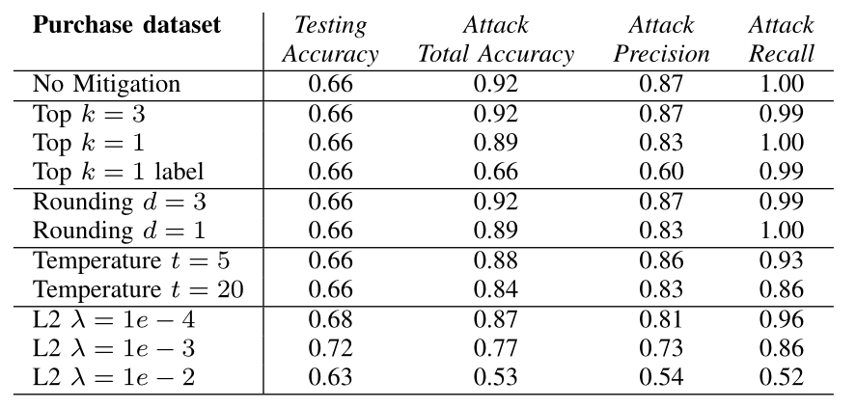
Mitigation of the attack

Slide 26
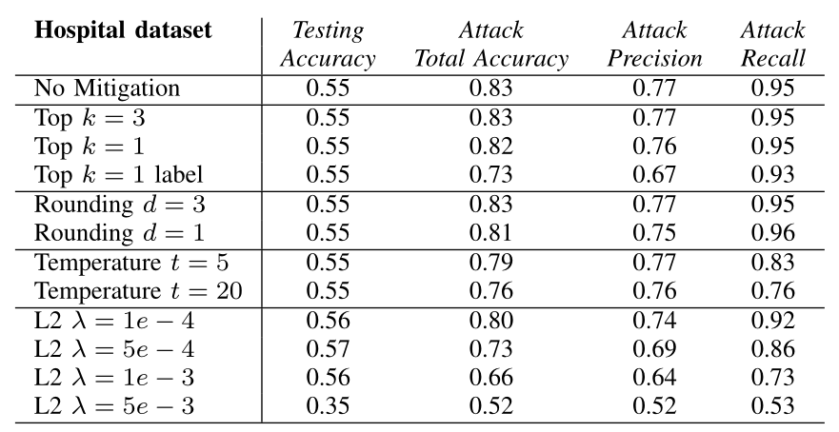
Mitigation of the attack

Slide 27
Thank You For Listening！
张文博 2022.05.27

